Slide 1
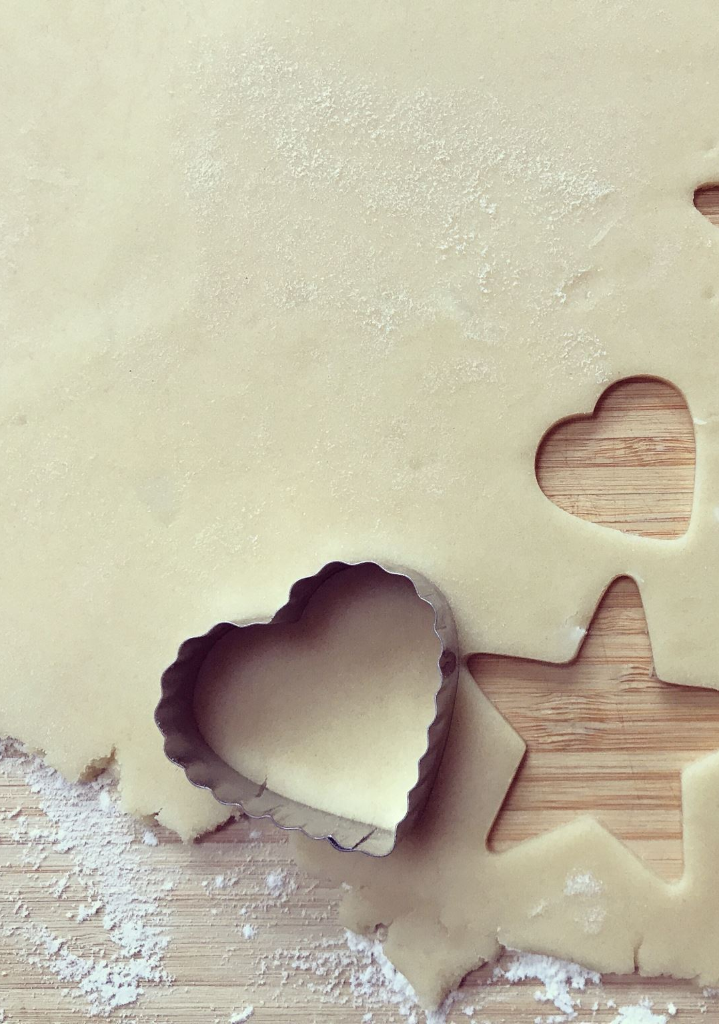
THE COOKIE PROJECT
DS163 Module 1 Project

Slide 2
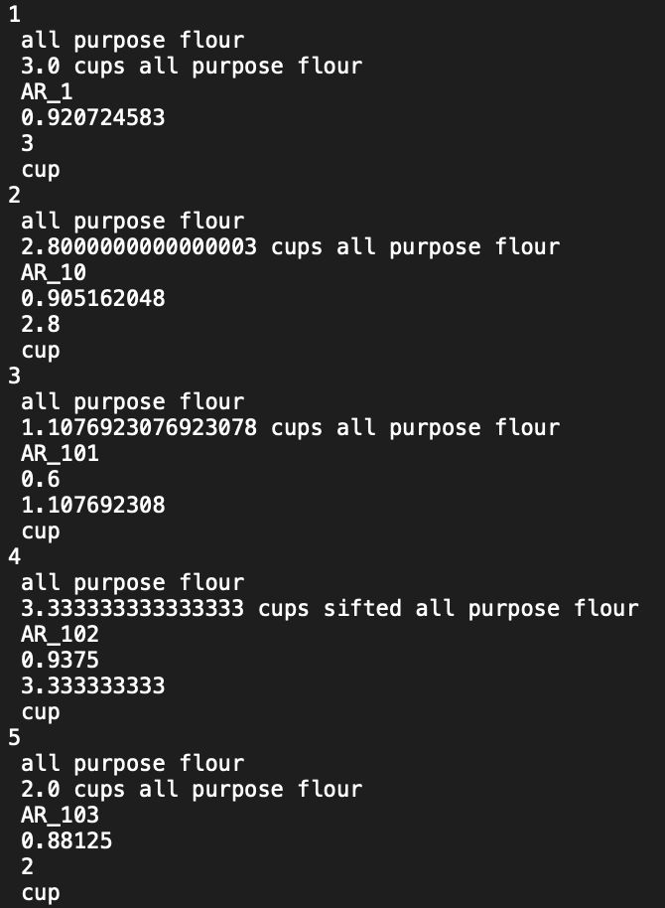
DAtaSet

Slide 3
YOUR TASKS (LECTURE)
Use the dataset to extract a BUSINESS INSIGHT
Tell a DATA STORY
Choose your audience
Bakers
Retail Store
Others

Slide 4
Format (LECTURE)
Maximum of 10-minute video presentation
Criteria | Weight | Remarks
Delivery | 25% | The speaker(s) showed mastery of the discussion
Visual | 15% | Appealing and engaging data viz
Technical Complexity | 25% | Use of appropriate data science techniques
Data Story | 35% | The story revolves on the DATA

Slide 5
YOUR TASKS (LABORATORY)
Using RegEX and other appropriate techniques, create a NEW TEXT FILE out of the given dataset that is ORGANIZED based on RECIPE.
Criteria | Weight
Correctness of Output | 50%
Proper Technique | 50%

Slide 6
SPECIFICATIONS
Group of not more than 4
LECTURE TASK: To be presented in class on APRIL 1, 2022
LAB TASK: To be submitted on MARCH 31, 2022

Slide 7
WHAT TO SUBMIT
Lecture: Notebook used for the data story
Lab: Notebook used to organize the text file

